Slide 1
Scaling up low hanging fruits
Seaweed Biorefinery

Slide 2
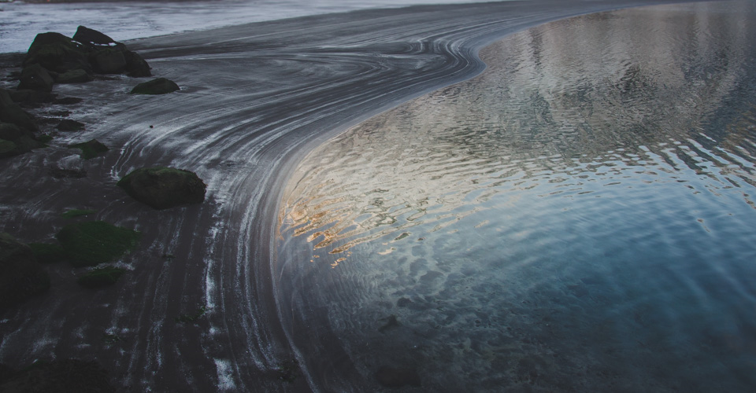
Main goal
Macro Cascade aims to develop a production
platform for processing sustainable
cultivated seaweed to highly
processed value
added products

Slide 3
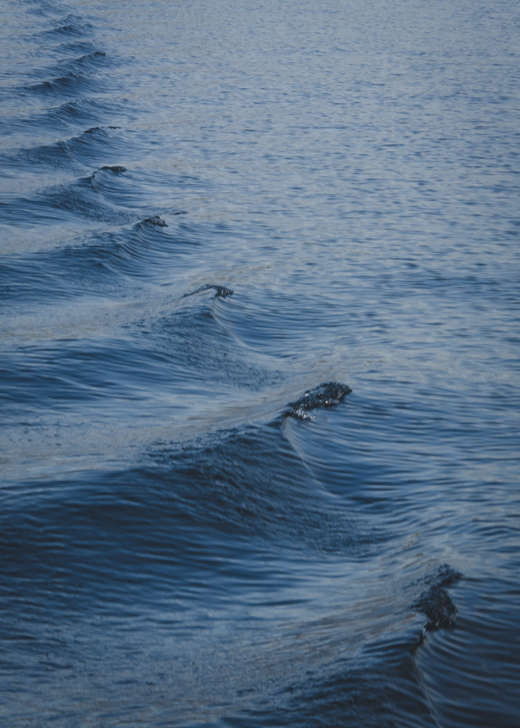
Challenges identified
Reliable seaweed biomass supply
Cost-efficient storage conditioning
Robust extraction and separation technologies
Efficient enzymatic refining
Sustainability assessment of entire value chain

Slide 4
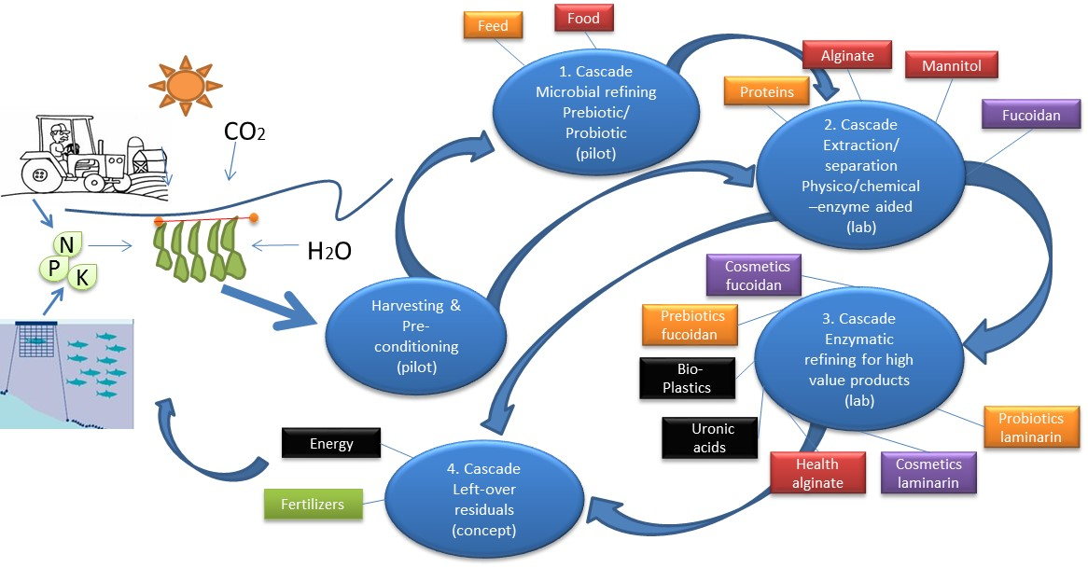
Objectives illustrated

Slide 5
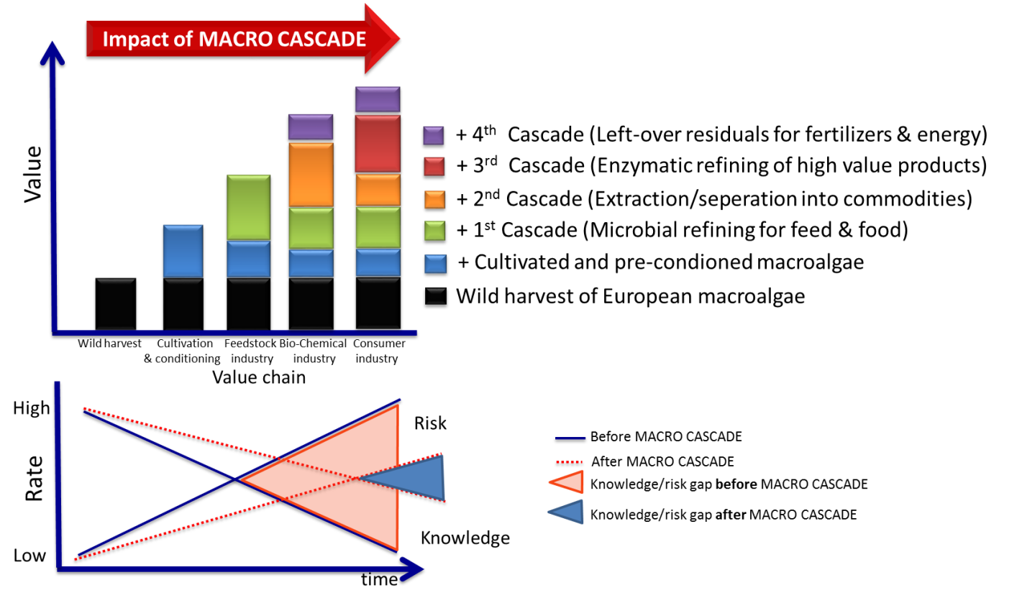
Impact
+ 4th Cascade (Left-over residuals for fertilizers & energy)
+ 3rd Cascade (Enzymatic refining of high value products)
+ 2nd Cascade (Extraction/separation into commodities)
+ 1st Cascade (Microbial refining for feed & food)
+ Cultivated and pre-conditioned macroalgae
Wild harvest of European macroalgae
Knowledge
Risk

Slide 6
Acknowledgement
This presentation is part of the Macro Cascade project. This project has received funding from the Bio-Based Industries Joint Undertaking under the European Union Horizon 2020 research and innovation program under grant agreement No 720755

Slide 7
